Slide 1
MATH 285 Week 13
DI 2

Slide 2
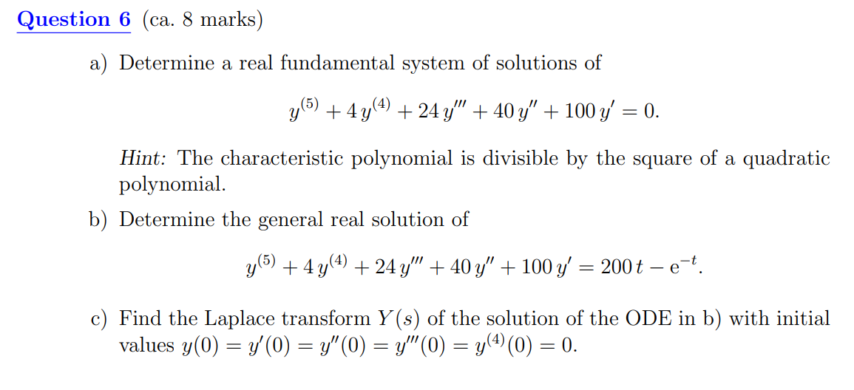

Slide 3
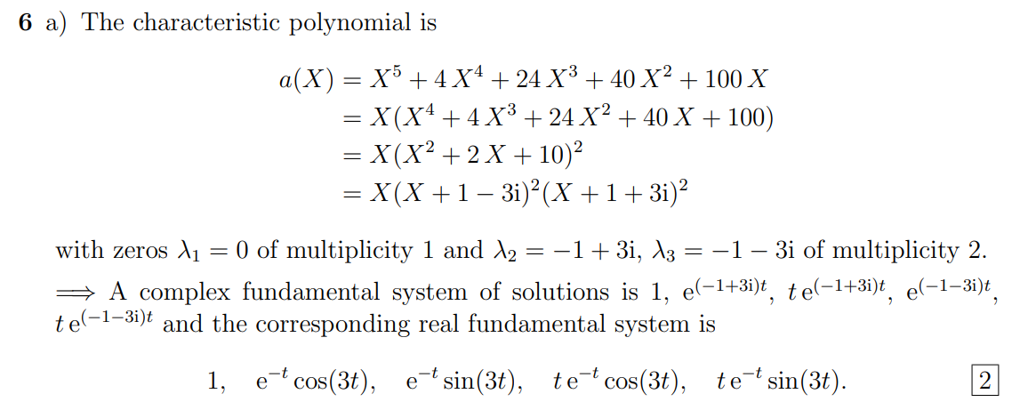

Slide 4
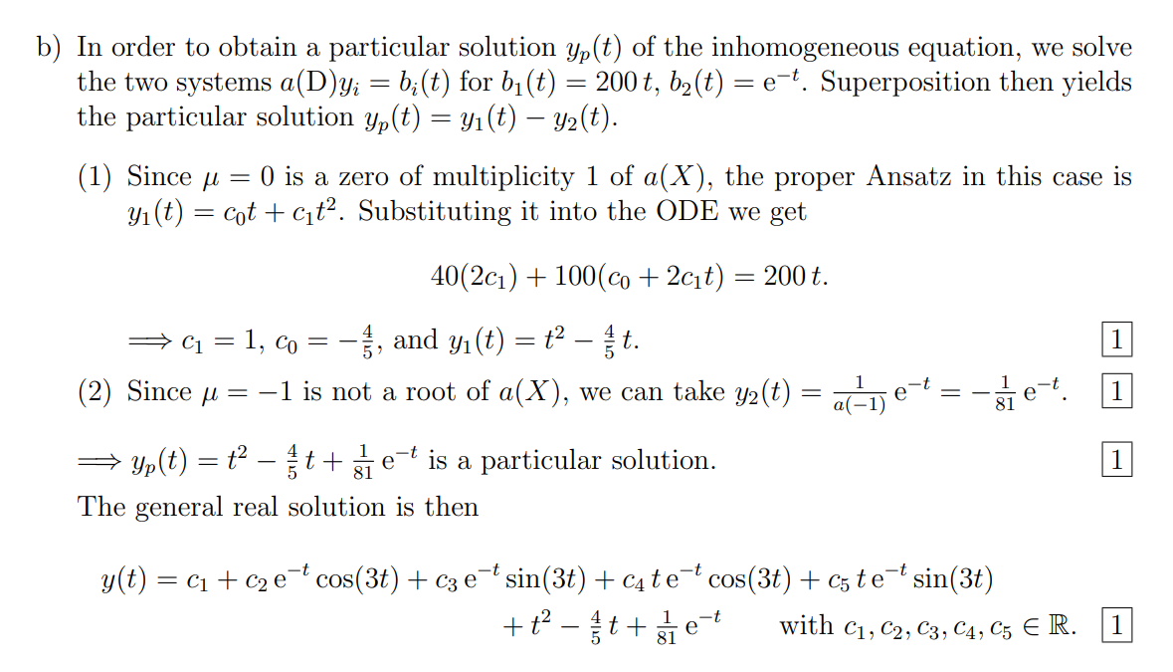

Slide 5
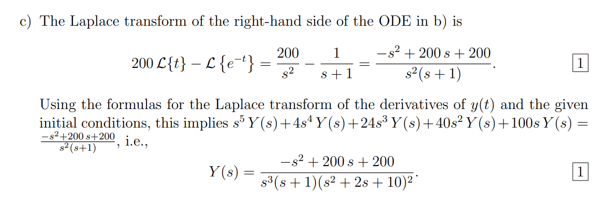

Slide 6
Most difficult (confusing) part of the final
first-order autonomous linear ODE system

Slide 7
Check lec 46-50 carefully
How to calculate determinant?
Eigenvalues
Eigenvectors
What to do after finding the eigenvectors?
What if there are repeated eigenvalues?
This is the only knowledge that I suggest to review slides instead of textbook

